Slide 1
Python GUI programming
Task 1: Outline
Task 2: Quick reference
Task 3: What is Tkinter
Task 4: Creating 3 widgets: a label, text entry and a button (and ‘PACK’)
Task 5: Editing background
Task 6: Getting input
Task 7:Passing Input
Task 8: Making the GUI look pretty!
Task 9 : Changing the position of the objects
Task 10: use of selection statements
Notes:
Associated Resource: Python GUI Solutions Folder:
Please see the above folder (as part of this resource) for the solutions for the given tasks/challenges.
They are linked to each task. Task 1 has an associated .py file (1_Python_create3widgets) Task 2 = 2_Python_Create_output_withLabel) etc.

Slide 2
Quick reference
A software bug is an error or flaw in a computer program.
As a programmer, you are going to come up a lot of these and it is important that you are patient and persevere!
The first ever bug was an actual bug!
Operators traced an error in the Mark II to a moth trapped in a relay, coining the term bug. This bug was carefully removed and taped to the log book
Stemming from this we now call glitches in a computer a bug.
Notes:
Image(s) source: wikipedia

Slide 3
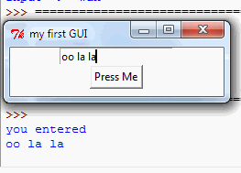
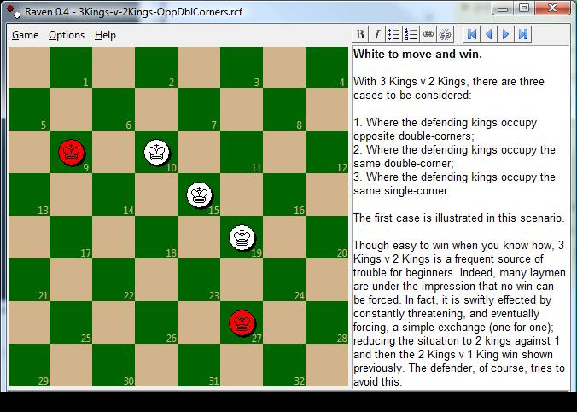
What is Tkinter?
Before we begin, you ought to know that the Tkinter module (“Tk interface”) is the standard Python interface to the Tk GUI toolkit from Scriptics (it was formerly developed by Sun Labs).
Simply put, Tkinter consists of a number of modules.
The Tk interface is provided by a binary extension module named _tkinter. This module contains the low-level interface to Tk, and should never be used directly by application programmers.
The public interface is provided through a number of Python modules. The most important interface module is the Tkinter module itself. To use Tkinter, all you need to do is to import the Tkinter module:
import Tkinter
Or, more often: from tkinter import *

Slide 4
Task 1: Creating 3 widgets.
Copy (or preferably type word for word) the code provided to create a simple GUI with a label, text entry box and button. Go to File – Run to execute the program.
#import the 'tkinter module
import tkinter
window = tkinter.Tk()
#create the title for the window
window.title("Creating 3 Widgets - label, textentry and button")
#creating a label widget (label1)
label1=tkinter.Label(window, text="Label")
#creating a text entry widget (txtentry)
txtentry=tkinter.Entry(window)
#creating a button widget (called btn)
btn=tkinter.Button(window, text ="Button")
#Adding the widgets, in order to the created window. Keyword =pack
label1.pack()
txtentry.pack()
btn.pack()
#Finally, draw the window + start the application
window.mainloop()
Anything beginning with a # is a “comment”. They are not part of the program
The 3 Variables that we are creating here are Label1, txtentry and btn. Particular widgets (or objects) are assigned to these variables.
Packing allows you to control the layout. If you change the order here, the order in which the widgets appear on the window will also change. Experiment a little!

Slide 5
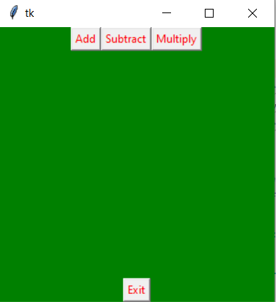
Challenge 1: Edit the design and labels
Change the code to get it looking like the shown screenshot.
Don’t worry about functionality yet – we will get to that!

Slide 6
Task 2: Getting some output!
Copy (or preferably type word for word) the code provided to create a simple GUI which asks for a user’s name and outputs a result “Hello there” (at this point it isn’t making any reference to the actual entered text)
#import the 'tkinter module
import tkinter
def mhello():
label1 = tkinter.Label(window, text="Hello, nice to meet you").pack()
window = tkinter.Tk()
#create the title for the window
window.title("Creating 3 Widgets - label, textentry and button")
#creating a label widget (label1)
label1=tkinter.Label(window, text="Enter your Name")
#creating a text entry widget (txtentry)
txtentry=tkinter.Entry(window)
#creating a button widget (called btn)
btn=tkinter.Button(window, text ="Click me now", command = mhello, fg='red')
#Adding the widgets, in order to the created window. Keyword =pack
label1.pack()
txtentry.pack()
btn.pack()
#Finally, draw the window + start the application
window.mainloop()
Step 2: Here we have defined the command mhello, and create the output to appear in another label.
Step 1: Add this bit of code to your previous program. It specifies the need to call a command called ‘mhello’ and also turns the foreground ‘red’

Slide 7
Task 3: Passing text input to label output
Copy (or preferably type word for word) the code provided to create a simple GUI which asks for a user’s name then outputs the entered name into another label. (this time it is actually storing the entered text as a variable and retrieving it for output)
Play around with the colour of the background and foreground of labels.
import sys
from tkinter import *
def hellothere():
texttopass = nameentry.get()
label2=Label(myGui, text=texttopass).pack()
return
myGui = Tk()
nameentry = StringVar()
myGui.geometry('450x450+400+300')
myGui.title('Hello there app')
Label1 = Label(myGui, text='Enter your name').pack()
button1=Button(myGui, text='Click me', command = hellothere, fg = 'white', bg = 'red').pack()
textentry1= Entry(myGui, textvariable=nameentry).pack()

Slide 8
Task 4: Making the GUI look pretty!
Copy (or preferably type word for word) the code provided to create a simple login system GUI. Experiment with changing the colour of the labels, buttons, and background of the window.
You can also include an image or logo to the window to make it look all the more professional. (see if you can google this to find out how! Remember this is Python 3)
import sys
from tkinter import *
myGui = Tk()
myGui.configure(background='light blue')
myGui.geometry('450x450+400+300')
myGui.title('Login Screen')
Label1 = Label(myGui, text='Username').pack()
textentry1= Entry(myGui).pack()
Label2 = Label(myGui, text='Password').pack()
textentry2= Entry(myGui).pack()
button1=Button(myGui, text='Login', fg = 'white', bg = 'blue').pack()

Slide 9
Using ‘Place’
Task 5: Changing the position of the objects
Copy the code provided.
You will notice the use of the PLACE keyword. (instead of Pack)
Inside, you specify the position of the object on the X and Y grid. X=0, Y=0 would be referring to the top left hand corner of the screen.
Challenge: See if you can fix the GUI to get all the objects lined up!
import sys
from tkinter import *
#often called 'root' instead of myGui
myGui = Tk()
myGui.configure(background='light blue')
myGui.geometry('450x450+500+300')
myGui.title('Login Screen')
Label1 = Label(myGui, text='Username').place(x=20, y=20)
textentry1= Entry(myGui).place(x=20, y=40)
Label2 = Label(myGui, text='Password').place(x=20, y=40)
textentry2= Entry(myGui).place(x=20, y=60)
button1=Button(myGui, text='Login', fg = 'white', bg = 'blue').place(x=20,y=80)
These two labels aren’t quite in the right place. Can you get them to line up properly (each to the left of its respective text entry box)
Notes:
*Please refer to PythonGUISolutionsFolder: Solution 5

Slide 10
Using ‘Grid’
Task 6: Changing the position of the objects
Copy the code provided.
This time we will be using the GRID method. (instead of Pack or Place)
import sys
from tkinter import *
#often called 'root' instead of myGui
myGui = Tk()
myGui.configure(background='light blue')
myGui.geometry('450x450+500+300')
myGui.title('Login Screen')
Label1 = Label(myGui, text='Username').grid(row=1,column=0, sticky=N)
textentry1= Entry(myGui).grid(row=0, column=0)
Label2 = Label(myGui, text='Password').grid(row=1,column=0)
textentry2= Entry(myGui).grid(row=1,column=1)
button1=Button(myGui, text='Login', fg = 'white', bg = 'blue').grid(row=0,column=0)
Look at the grid layout hint on the left and see if you can change the row and column numbers below to get this to line up correctly!
 | Column 0 | Column 1
Row 0 | Username Label | Text Entry 1 Box
Row 1 | Password Label | Text Entry 2 Box
Row 2 | Submit Button
Notes:
See Folder: Python GUI Solutions: 6b – contains the correct solution

Slide 11
Using ‘pack’ and ‘side=LEFT padx’
6c: A few more tips and tricks on layout!
import sys
from tkinter import *
myGui = Tk()
nameentry = StringVar()
#myGui.geometry('450x450')
myGui.title('Playing with the layout of Buttons')
Label1 = Label(myGui, text='Enter Text Here').pack()
textentry1= Entry(myGui, textvariable=nameentry).pack()
button1=Button(myGui, text='Button 1').pack(side=LEFT,padx=5)
button2=Button(myGui, text='Button 2').pack(side=LEFT,padx=5)
button3=Button(myGui, text='Button 3').pack(side=LEFT,padx=5)
button4=Button(myGui, text='Button 4').pack(side=LEFT,padx=5)
Try it yourself. Experiment with what will happen if you change the ‘padx’ value to 10….or 20! (how it will affect the spacing of the buttons)
Notes:
See Folder: Python GUI Solutions: 6b – contains the correct solution

Slide 12
Using ‘Grid’
6d: A few more tips and tricks on layout!
import sys
from tkinter import *
myGui = Tk()
#myGui.geometry('450x450')
myGui.title('Playing with the layout of Buttons')
button1=Button(myGui, text='Button 1')
button2=Button(myGui, text='Button 2')
button1.grid(row=0,column=0)
button2.grid(row=1,column=1)
Try it yourself. Add a few more buttons and get to line up in a vertical line one after the other.
It may be helpful for you to draw a rough sketch of rows and columns and then assign each button its respective row and column numeric value.
Notes:
See Folder: Python GUI Solutions: 6b – contains the correct solution

Slide 13
Using the Frame method
6e: More Complex Layout (Using Frames)
import sys
from tkinter import *
myGui = Tk()
myGui.title('Using a Frame')
f = Frame(myGui)
button1 = Button(f, text="Button 1")
button2 = Button(f, text="Button 2")
button3 = Button(f, text="Button 3")
button1.pack(side=LEFT)
button2.pack(side=LEFT)
button3.pack(side=LEFT)
label1 = Label(myGui, text="Working with frames")
label1.pack()
f.pack()
A frame is just a widget and all it does is – contain other widgets!
This allows groups of widgets, whether packed or placed in a grid, to be combined into a single Frame.
Frames may then be packed with other widgets and frames.
This feature lets us create just about any kind of layout (a useful thing to know if you are creating more complicated interfaces). *the place method would take ages if you had a lot to work with!
Notes:
See Folder: Python GUI Solutions: 6b – contains the correct solution

Slide 14
Task 7a: Use of selection (If statement)
See speaker notes for solution (for username and password solution)
Copy the code provided.
Here we will see text entry and the use of SELECTION (an if statement) that will decide on the output depending on whether or not the input is correct, as specified,
Challenge: Can you extend this to create a full login screen (username and password both need to be correct for access to be granted) Try it yourself before looking at the answers (next slide)
import sys
from tkinter import *
myGui = Tk()
myGui.geometry('450x450+400+300')
myGui.title('Hello there app')
Label1 = Label(myGui, text='Say Hello').pack()
E1=Entry(myGui)
E1.pack()
def hellothere():
if E1.get()=="Hello":
welcome=Label(myGui,text="Hello to you too!")
welcome.pack()
else:
denied=Label(myGui,text="Sorry, You need to follow instructions!")
denied.pack()
button1=Button(myGui, text='Click me', command = hellothere, fg = 'white', bg = 'red').pack()
Notes:
Solution for Username and Password Program is in Python GUI Solutions Folder – see 7b (also pasted below)
#import tkinter
from tkinter import *
#to initialise tkinter we have to create a Tk root widget
#this is basically an ordinary window, with a title bar and other decoration as necessary
#the root widget (only one can be created for each program) must be created before any other widgets
root = Tk()
#creating and packing a Label which says "Login Screen"
w = Label(root, text="Login Screen")
w.pack()
#creating and packing a Label which has lots of stars!
e1 = Label(root, text="******************************")
e1.pack()
#creating and packing a Label which says "Username"
w1 = Label(root, text="Username")
w1.pack()
#creating and packing a text entry input box (this will come under Username)
e = Entry(root)
e.pack()
#creating and packing a Label which says "Username"
w2 = Label(root, text="Password")
w2.pack()
#creating and packing a second text entry input box (this will come under Username)
e1 = Entry(root)
e1.pack()
#This is another interesting layout feature - it creates a tool bar
toolbar = Frame(root)
#creates a button (variable b) called 'Enter'
b = Button(toolbar, text="Enter", width=9)
b.pack(side=LEFT, padx=2, pady=2)
#creates a button called 'Cancel'
b = Button(toolbar, text="Cancel", width=9)
b.pack(side=LEFT, padx=2, pady=2)
#This is the interesting bit - it's a function called 'callback
#it has an IF function that asks for two specific text inputs for username and password
#it displays a label message depending on whether the input was valid
def callback():
if e.get()=="Hello" and e1.get()=="God":
welcome = Label(root,text="Welcome - Access Granted")
welcome.pack()
else:
denied = Label(root,text="Sorry, Access Denied")
denied.pack()
#This produces a final 'Sign up' button -it's in order, so goes after the 'Cancel' Button
#Notice it is this button that contains a CALL to the callback function above.
b = Button(toolbar, text="Sign-Up", command=callback, width=9)
b.pack(side=LEFT, padx=2, pady=2)
#this defines the position and layout of the toolbar.
toolbar.pack(side=TOP, fill=X)

Slide 15
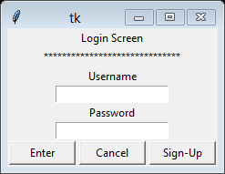
Task 7b: Use of selection (If statement)
See speaker notes for solution (for username and password solution)
Login application:
Copy the code!
Only if the provided username and password match, will access be granted, else, access denied.
Challenge: Play around with the code and see if you can add an additional required entry (e.g. code number).
#import tkinter
from tkinter import *
#to initialise tkinter we have to create a Tk root widget
#this is basically an ordinary window, with a title bar and other decoration as necessary
#the root widget (only one can be created for each program) must be created before any other widgets
root = Tk()
#creating and packing a Label which says "Login Screen"
w = Label(root, text="Login Screen")
w.pack()
#creating and packing a Label which has lots of stars!
e1 = Label(root, text="******************************")
e1.pack()
#creating and packing a Label which says "Username"
w1 = Label(root, text="Username")
w1.pack()
#creating and packing a text entry input box (this will come under Username)
e = Entry(root)
e.pack()
#creating and packing a Label which says "Username"
w2 = Label(root, text="Password")
w2.pack()
#creating and packing a second text entry input box (this will come under Username)
e1 = Entry(root)
e1.pack()
#This is another interesting layout feature - it creates a tool bar
toolbar = Frame(root)
#creates a button (variable b) called 'Enter'
b = Button(toolbar, text="Enter", width=9)
b.pack(side=LEFT, padx=2, pady=2)
#creates a button called 'Cancel'
b = Button(toolbar, text="Cancel", width=9)
b.pack(side=LEFT, padx=2, pady=2)
#This is the interesting bit - it's a function called 'callback
#it has an IF function that asks for two specific text inputs for username and password
#it displays a label message depending on whether the input was valid
def callback():
if e.get()=="Hello" and e1.get()=="God":
welcome = Label(root,text="Welcome - Access Granted")
welcome.pack()
else:
denied = Label(root,text="Sorry, Access Denied")
denied.pack()
#This produces a final 'Sign up' button -it's in order, so goes after the 'Cancel' Button
#Notice it is this button that contains a CALL to the callback function above.
b = Button(toolbar, text="Sign-Up", command=callback, width=9)
b.pack(side=LEFT, padx=2, pady=2)
#this defines the position and layout of the toolbar.
toolbar.pack(side=TOP, fill=X)
Notes:
Solution for Username and Password Program is in Python GUI Solutions Folder – see 7b (also pasted below)
#import tkinter
from tkinter import *
#to initialise tkinter we have to create a Tk root widget
#this is basically an ordinary window, with a title bar and other decoration as necessary
#the root widget (only one can be created for each program) must be created before any other widgets
root = Tk()
#creating and packing a Label which says "Login Screen"
w = Label(root, text="Login Screen")
w.pack()
#creating and packing a Label which has lots of stars!
e1 = Label(root, text="******************************")
e1.pack()
#creating and packing a Label which says "Username"
w1 = Label(root, text="Username")
w1.pack()
#creating and packing a text entry input box (this will come under Username)
e = Entry(root)
e.pack()
#creating and packing a Label which says "Username"
w2 = Label(root, text="Password")
w2.pack()
#creating and packing a second text entry input box (this will come under Username)
e1 = Entry(root)
e1.pack()
#This is another interesting layout feature - it creates a tool bar
toolbar = Frame(root)
#creates a button (variable b) called 'Enter'
b = Button(toolbar, text="Enter", width=9)
b.pack(side=LEFT, padx=2, pady=2)
#creates a button called 'Cancel'
b = Button(toolbar, text="Cancel", width=9)
b.pack(side=LEFT, padx=2, pady=2)
#This is the interesting bit - it's a function called 'callback
#it has an IF function that asks for two specific text inputs for username and password
#it displays a label message depending on whether the input was valid
def callback():
if e.get()=="Hello" and e1.get()=="God":
welcome = Label(root,text="Welcome - Access Granted")
welcome.pack()
else:
denied = Label(root,text="Sorry, Access Denied")
denied.pack()
#This produces a final 'Sign up' button -it's in order, so goes after the 'Cancel' Button
#Notice it is this button that contains a CALL to the callback function above.
b = Button(toolbar, text="Sign-Up", command=callback, width=9)
b.pack(side=LEFT, padx=2, pady=2)
#this defines the position and layout of the toolbar.
toolbar.pack(side=TOP, fill=X)

